Slide 1

Sustainable Software Engineering in AI OSS Supply Chain
Socrates WP4 Literature Review
Jason Xue WP4 Lead | 27/01/2023

Slide 2
Research Questions
RQ 1: What is the current state of research on fairness software engineering in AI OSS supply chain?
RQ 2: What is a comprehensive list of general fairness risks on AI OSS supply chains?
RQ 3: Which fairness enhancing techniques exist, and what is the utility and cost of those enhancing techniques?

Slide 3
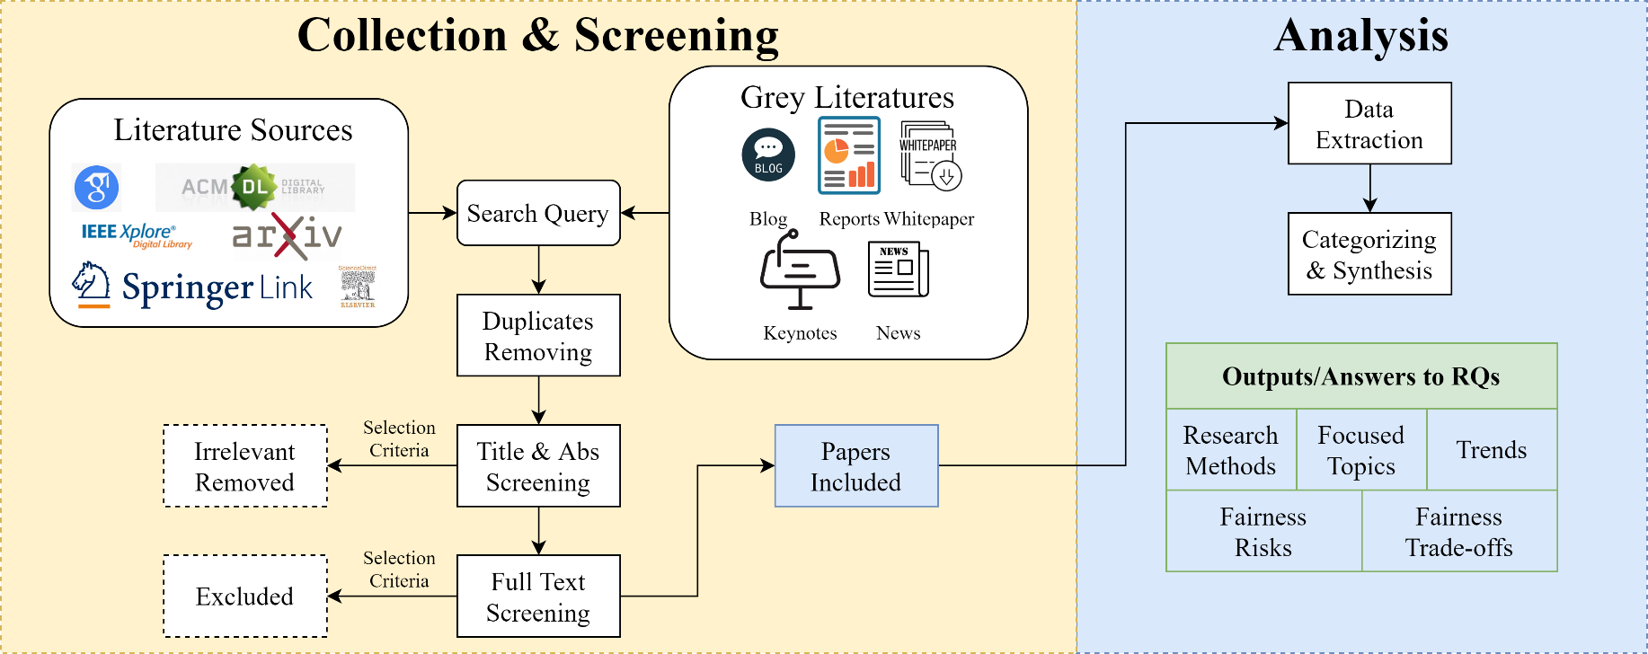
Methodology Overview

Slide 4
Methodology - Collection
Sources
Scientific literature review: Google Scholar, IEEExplore, ACM Digital Library, ScienceDirect, SpringerLink, and arXiv
Grey literature review: blog, reports, news, whitepapers, keynotes, etc
Search string
fair*/unfair*/fairness-aware
artificial intelligence/machine learning/computer vision/prediction/classification
software development/software engineering/software design/software requirement/software product
supply chain/supply-chain
open source/open-source/OSS/free/libre/FLOSS

Slide 5
Methodology - Screening
Selection Criteria
Published on or after a timestamp, e.g., 1/1/2013
Full text is accessible in English
Explicitly relates to fairness
The research context is explicitly software development or software products
Exclusion criteria
Less than 3 pages long
The paper is an introduction to a special issue or workshop
The paper has been withdrawn
Paper screening
Manually or through tools -> removing duplicates
Title and abstract screening -> removing irrelevant studies
Full text review -> removing irrelevant studies and categorising remaining papers

Slide 6
Methodology - Data Extraction & Synthesis
Categorizing and data extraction
List of authors, title, year of publication, publication type
Topic of study, objective, research method (Empirical Standards for Software Engineering Research [1,2])
Definition of fairness used
Type of fairness risks considered
Enhancing technology introduced
Summarizing and Synthesis
[1] P. Ralph, “Empirical standards for software engineering research,” arXiv preprint arXiv:2010.03525, 2020.
[2] https://acmsigsoft.github.io/EmpiricalStandards/docs/

Slide 7
Expected Outputs
Answers to RQ1
Empirical methods used by primary studies
Focus of primary studies
Fairness risks considered
Fairness enhancing techniques introduced (utility-cost trade-off)
Most prolific authors
Temporal trends (papers/year)
Answers to RQ2 & 3

